Slide 1

Computer Networks: A Systems Approach, 5e
Larry L. Peterson and Bruce S. Davie
Chapter 3
Internetworking
This work is licensed under a Creative Commons Attribution 4.0 License.

Slide 2
Problems
In Chapter 2 we saw how to connect one node to another, or to an existing network. How do we build networks of global scale?
How do we interconnect different types of networks to build a large global network?

Slide 3
Chapter Outline
Switching and Bridging
Basic Internetworking (IP)
Routing
Implementation

Slide 4
Chapter Goal
Understanding the functions of switches, bridges and routers
Discussing Internet Protocol (IP) for interconnecting networks
Understanding the concept of routing

Slide 5
Switching and Forwarding
Store-and-Forward Switches
Bridges and Extended LANs
Cell Switching
Segmentation and Reassembly

Slide 6
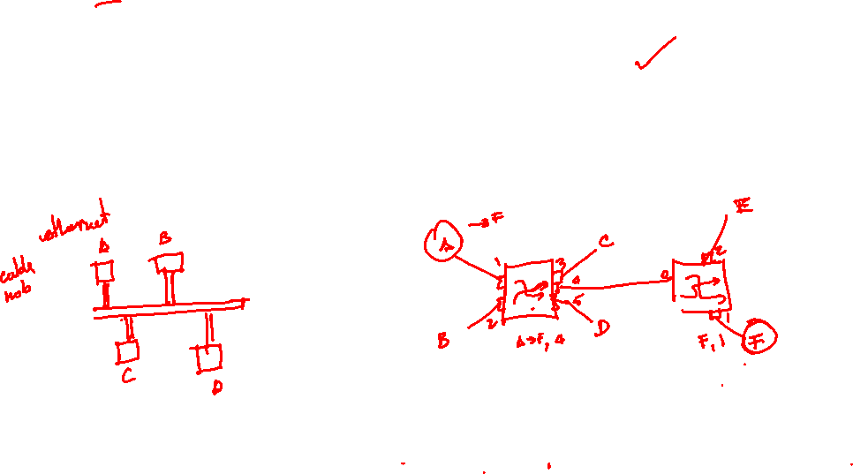
Switching and Forwarding
Switch
A mechanism that allows us to interconnect links to form a large network
A multi-input, multi-output device which transfers packets from an input to one or more outputs

Slide 7
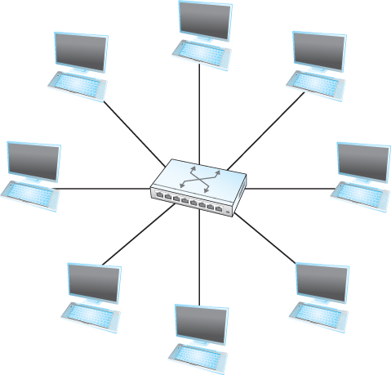

Switching and Forwarding
Adds the star topology to the point-to-point link,
bus (Ethernet), and ring (802.5 and FDDI)
topologies

Slide 8
Switching and Forwarding
Properties of this star topology
Even though a switch has a fixed number of inputs and outputs, which limits the number of hosts that can be connected to a single switch, large networks can be built by interconnecting a number of switches
We can connect switches to each other and to hosts using point-to-point links, which typically means that we can build networks of large geographic scope
Adding a new host to the network by connecting it to a switch does not necessarily mean that the hosts already connected will get worse performance from the network

Slide 9
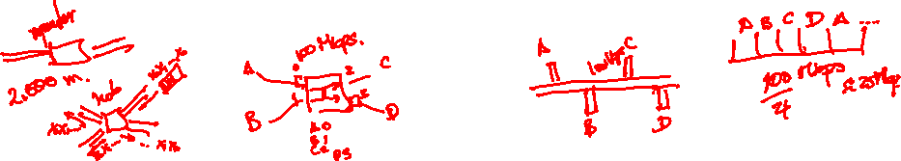
Switching and Forwarding
The last claim cannot be made for the shared media network (discussed in Chapter 2)
It is impossible for two hosts on the same Ethernet to transmit continuously at 10Mbps because they share the same transmission medium
Every host on a switched network has its own link to the switch
So it may be entirely possible for many hosts to transmit at the full link speed (bandwidth) provided that the switch is designed with enough aggregate capacity

Slide 10
Switching and Forwarding
A switch is connected to a set of links and for each of these links, runs the appropriate data link protocol to communicate with that node
A switch’s primary job is to receive incoming packets on one of its links and to transmit them on some other link
This function is referred as switching and forwarding
According to OSI architecture this is the main function of the network layer

Slide 11
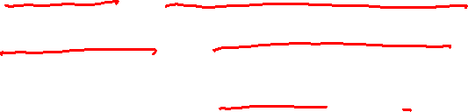
Switching and Forwarding
How does the switch decide which output port to place each packet on?
It looks at the header of the packet for an identifier that it uses to make the decision
Two common approaches
Datagram or Connectionless approach
Virtual circuit or Connection-oriented approach
A third approach source routing is less common

Slide 12
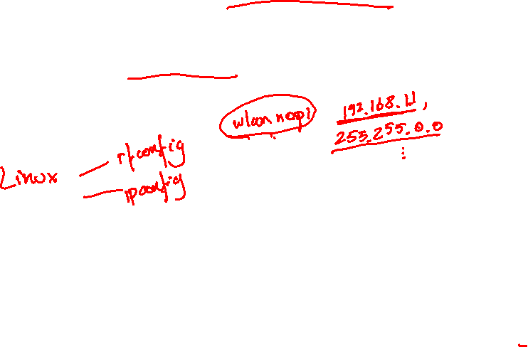
Switching and Forwarding
Assumptions
Each host has a globally unique address
There is some way to identify the input and output ports of each switch
We can use numbers
We can use names

Slide 13
Switching and Forwarding
Datagrams
Key Idea
Every packet contains enough information to enable any switch to decide how to get it to destination
Every packet contains the complete destination address

Slide 14
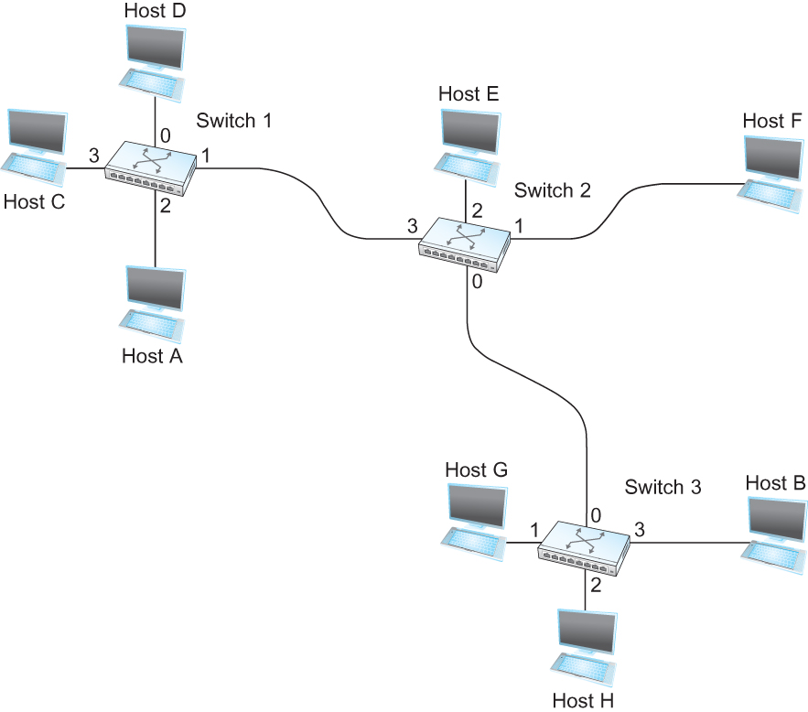
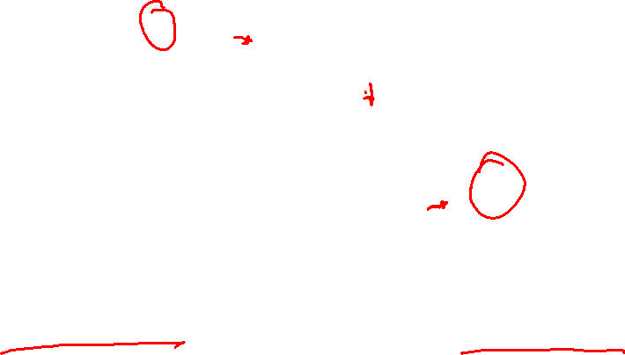
Switching and Forwarding
An example network
To decide how to forward a packet, a switch consults a forwarding table (sometimes called a routing table)

Slide 15
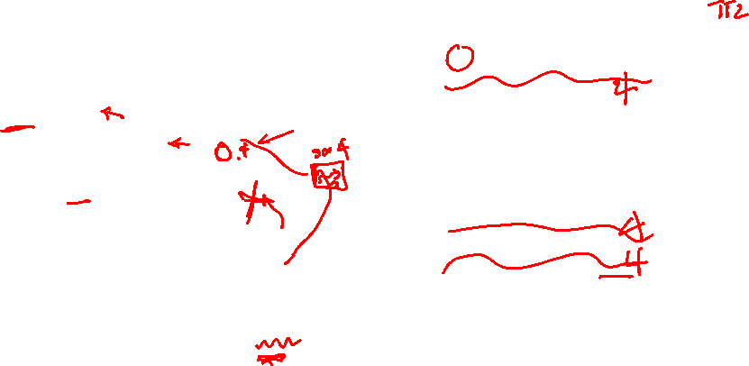
Switching and Forwarding
Destination Port
-------------------------------------
A 3
B 0
C 3
D 3
E 2
F 1
G 0
H 0
Forwarding Table for Switch 2

Slide 16
Switching and Forwarding
Characteristics of Connectionless (Datagram) Network
A host can send a packet anywhere at any time, since any packet that turns up at the switch can be immediately forwarded (assuming a correctly populated forwarding table)
When a host sends a packet, it has no way of knowing if the network is capable of delivering it or if the destination host is even up and running
Each packet is forwarded independently of previous packets that might have been sent to the same destination.
Thus two successive packets from host A to host B may follow completely different paths
A switch or link failure might not have any serious effect on communication if it is possible to find an alternate route around the failure and update the forwarding table accordingly

Slide 17
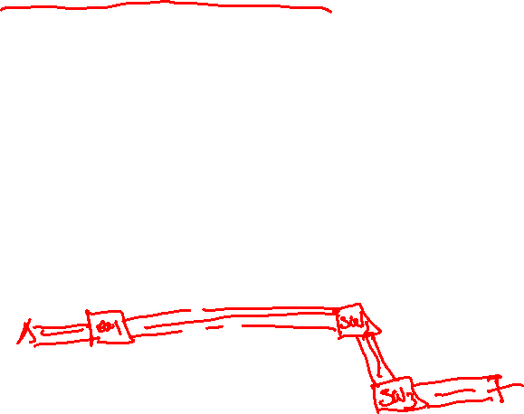
Switching and Forwarding
Virtual Circuit Switching
Widely used technique for packet switching (but less than it used to be)
Uses the concept of virtual circuit (VC)
Also called a connection-oriented model
First set up a virtual connection from the source host to the destination host and then send the data

Slide 18
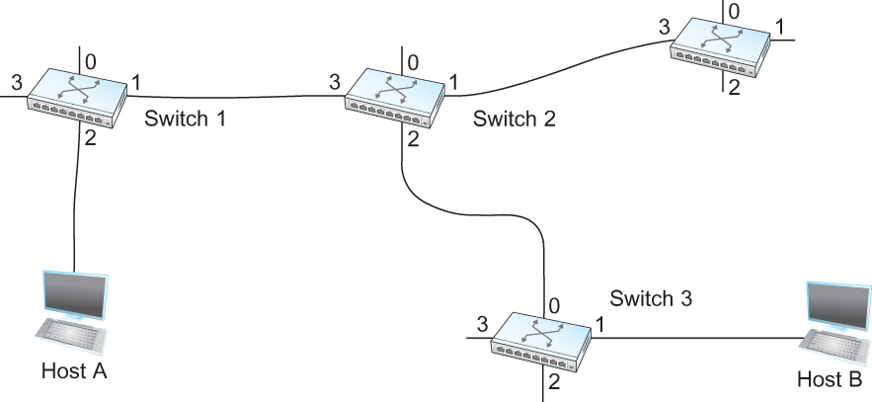
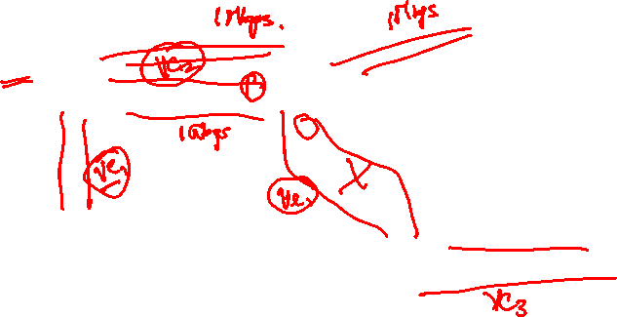
Switching and Forwarding
Host A wants to send packets to host B

Slide 19
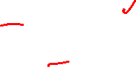
Switching and Forwarding
Two-stage process
Connection setup
Data Transfer
Connection setup
Establish “connection state” in each of the switches between the source and destination hosts
The connection state for a single connection consists of an entry in the “VC table” in each switch through which the connection passes

Slide 20
Switching and Forwarding
One entry in the VC table on a single switch contains
A virtual circuit identifier (VCI) that uniquely identifies the connection at this switch and that will be carried inside the header of the packets that belong to this connection
An incoming interface on which packets for this VC arrive at the switch
An outgoing interface in which packets for this VC leave the switch
A potentially different VCI that will be used for outgoing packets
The semantics for one such entry is
If a packet arrives on the designated incoming interface and that packet contains the designated VCI value in its header, then the packet should be sent out the specified outgoing interface with the specified outgoing VCI value first having been placed in its header

Slide 21
Switching and Forwarding
Note:
The combination of the VCI of the packets as they are received at the switch and the interface on which they are received uniquely identifies the virtual connection
There may be many virtual connections established in the switch at one time
Incoming and outgoing VCI values are not generally the same
VCI is not a globally significant identifier for the connection; rather it has significance only on a given link
Whenever a new connection is created, we need to assign a new VCI for that connection on each link that the connection will traverse
We also need to ensure that the chosen VCI on a given link is not currently in use on that link by some existing connection.

Slide 22
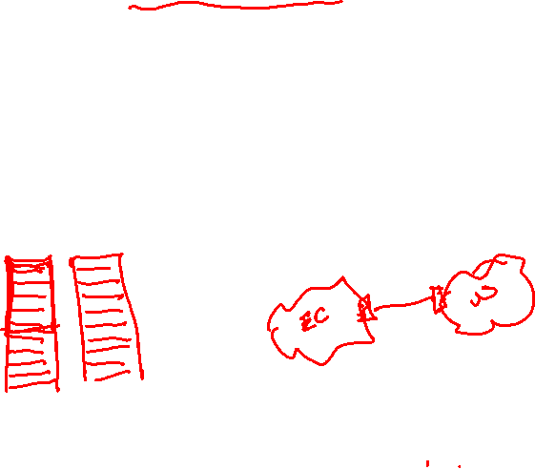
Switching and Forwarding
Two broad classes of approach to establishing connection state
Network Administrator will configure the state
The virtual circuit is permanent (PVC)
The network administrator can delete this
Can be thought of as a long-lived or administratively configured VC
A host can send messages into the network to cause the state to be established
This is referred as signalling and the resulting virtual circuit is said to be switched (SVC)
A host may set up and delete such a VC dynamically without the involvement of a network administrator

Slide 23
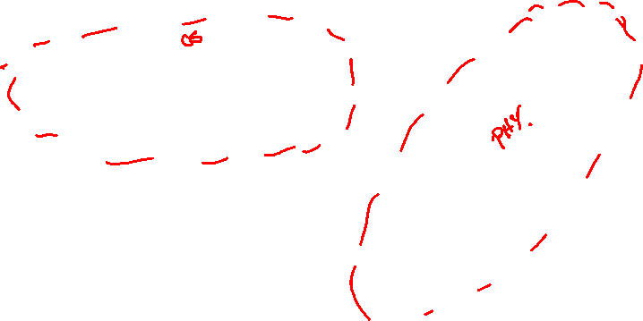
Switching and Forwarding
Let’s assume that a network administrator wants to manually create a new virtual connection from host A to host B
First the administrator identifies a path through the network from A to B

Slide 24
Switching and Forwarding
The administrator then picks a VCI value that is currently unused on each link for the connection
For our example,
Suppose the VCI value 5 is chosen for the link from host A to switch 1
11 is chosen for the link from switch 1 to switch 2
So the switch 1 will have an entry in the VC table
Incoming Interface | Incoming VC | Outgoing Interface | Outgoing VC
2 | 5 | 1 | 11

Slide 25
Switching and Forwarding
Similarly, suppose
VCI of 7 is chosen to identify this connection on the link from switch 2 to switch 3
VCI of 4 is chosen for the link from switch 3 to host B
Switches 2 and 3 are configured with the following VC table
Incoming Interface | Incoming VC | Outgoing Interface | Outgoing VC
3 | 11 | 2 | 7
Incoming Interface | Incoming VC | Outgoing Interface | Outgoing VC
0 | 7 | 1 | 4

Slide 26
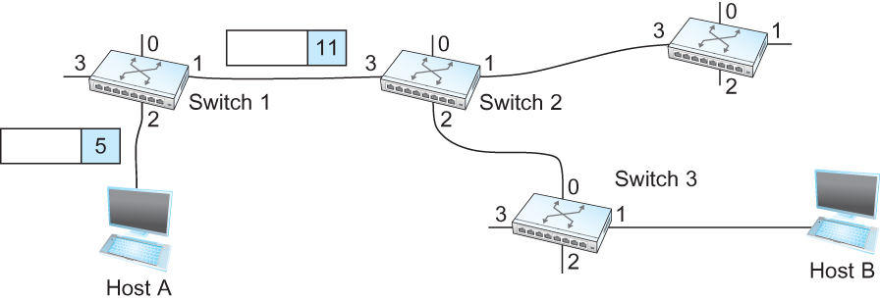
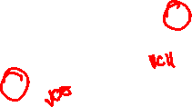
Switching and Forwarding
For any packet that A wants to send to B, A puts the VCI value 5 in the header of the packet and sends it to switch 1
Switch 1 receives any such packet on interface 2, and it uses the combination of the interface and the VCI in the packet header to find the appropriate VC table entry.
The table entry on switch 1 tells the switch to forward the packet out of interface 1 and to put the VCI value 11 in the header

Slide 27
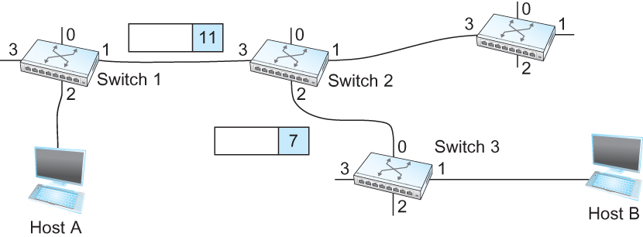
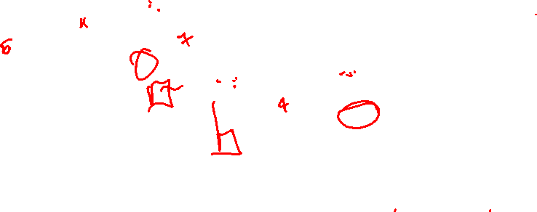
Switching and Forwarding
Packet will arrive at switch 2 on interface 3 bearing VCI 11
Switch 2 looks up interface 3 and VCI 11 in its VC table and sends the packet on to switch 3 after updating the VCI value appropriately
This process continues until it arrives at host B with the VCI value of 4 in the packet
To host B, this identifies the packet as having come from host A

Slide 28
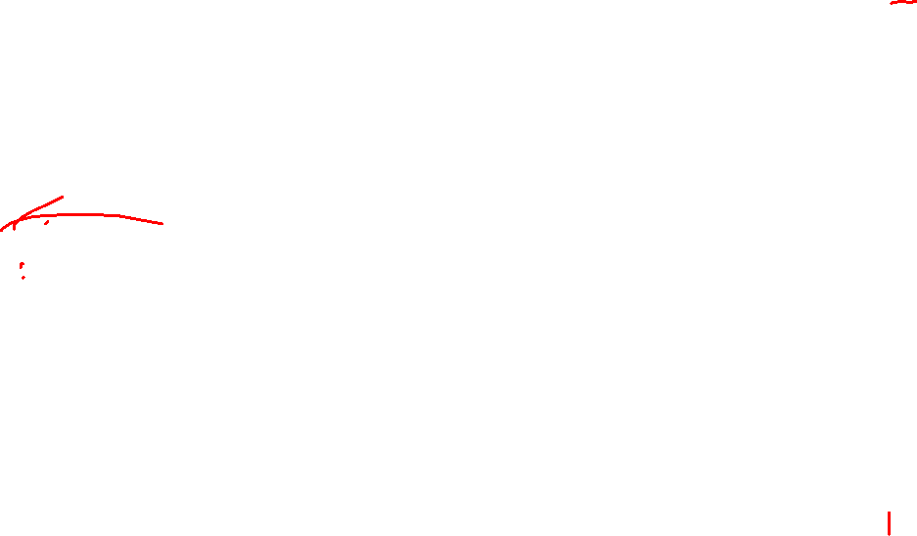
Switching and Forwarding
In real networks of reasonable size, the burden of configuring VC tables correctly in a large number of switches would quickly become excessive
Thus, some sort of signalling is almost always used, even when setting up “permanent” VCs
In case of PVCs, signalling is initiated by the network administrator
SVCs are usually set up using signalling by one of the hosts

Slide 29
Switching and Forwarding
How does the signalling work
To start the signalling process, host A sends a setup message into the network (i.e. to switch 1)
The setup message contains (among other things) the complete destination address of B.
The setup message needs to get all the way to B to create the necessary connection state in every switch along the way
It is like sending a datagram to B where every switch knows which output to send the setup message so that it eventually reaches B
Assume that every switch knows the topology to figure out how to do that
When switch 1 receives the connection request, in addition to sending it on to switch 2, it creates a new entry in its VC table for this new connection
The entry is exactly the same shown in the previous table
Switch 1 picks the value 5 for this connection

Slide 30
Switching and Forwarding
How does the signalling work (contd.)
When switch 2 receives the setup message, it performs the similar process and it picks the value 11 as the incoming VCI
Similarly switch 3 picks 7 as the value for its incoming VCI
Each switch can pick any number it likes, as long as that number is not currently in use for some other connection on that port of that switch
Finally the setup message arrives at host B.
Assuming that B is healthy and willing to accept a connection from host A, it allocates an incoming VCI value, in this case 4.
This VCI value can be used by B to identify all packets coming from A

Slide 31
Switching and Forwarding
Now to complete the connection, everyone needs to be told what their downstream neighbor is using as the VCI for this connection
Host B sends an acknowledgement of the connection setup to switch 3 and includes in that message the VCI value that it chose (4)
Switch 3 completes the VC table entry for this connection and sends the acknowledgement on to switch 2 specifying the VCI of 7
Switch 2 completes the VC table entry for this connection and sends acknowledgement on to switch 1 specifying the VCI of 11
Finally switch 1 passes the acknowledgement on to host A telling it to use the VCI value of 5 for this connection

Slide 32
Switching and Forwarding
When host A no longer wants to send data to host B, it tears down the connection by sending a teardown message to switch 1
The switch 1 removes the relevant entry from its table and forwards the message on to the other switches in the path which similarly delete the appropriate table entries
At this point, if host A were to send a packet with a VCI of 5 to switch 1, it would be dropped as if the connection had never existed

Slide 33
Switching and Forwarding
Characteristics of VC
Since host A has to wait for the connection request to reach the far side of the network and return before it can send its first data packet, there is at least one RTT of delay before data is sent
While the connection request contains the full address for host B (which might be quite large, being a global identifier on the network), each data packet contains only a small identifier, which is only unique on one link.
Thus the per-packet overhead caused by the header is reduced relative to the datagram model
If a switch or a link in a connection fails, the connection is broken and a new one will need to be established.
Also the old one needs to be torn down to free up table storage space in the switches
The issue of how a switch decides which link to forward the connection request on has similarities with the function of a routing algorithm

Slide 34
Switching and Forwarding
Good Properties of VC
By the time the host gets the go-ahead to send data, it knows quite a lot about the network-
For example, that there is really a route to the receiver and that the receiver is willing to receive data
It is also possible to allocate resources to the virtual circuit at the time it is established

Slide 35
Switching and Forwarding
For example, an X.25 network – a packet-switched network that uses the connection-oriented model – employs the following three-part strategy
Buffers are allocated to each virtual circuit when the circuit is initialized
The sliding window protocol is run between each pair of nodes along the virtual circuit, and this protocol is augmented with the flow control to keep the sending node from overrunning the buffers allocated at the receiving node
The circuit is rejected by a given node if not enough buffers are available at that node when the connection request message is processed

Slide 36
Switching and Forwarding
Comparison with the Datagram Model
Datagram network has no connection establishment phase and each switch processes each packet independently
Each arriving packet competes with all other packets for buffer space
If there are no buffers, the incoming packet must be dropped
In VC, we could imagine providing each circuit with a different quality of service (QoS)
The network gives the user some kind of performance related guarantee
Switches set aside the resources they need to meet this guarantee
For example, a percentage of each outgoing link’s bandwidth
Delay tolerance on each switch
Most popular examples of VC technologies are Frame Relay and ATM
One of the applications of Frame Relay is the construction of VPN

Slide 37
Switching and Forwarding
ATM (Asynchronous Transfer Mode)
Connection-oriented packet-switched network
Packets are called cells
5 byte header + 48 byte payload
Fixed length packets are easier to switch in hardware
Simpler to design
Enables parallelism

Slide 38
Switching and Forwarding
ATM
User-Network Interface (UNI)
Host-to-switch format
GFC: Generic Flow Control
VCI: Virtual Circuit Identifier
Type: management, congestion control
CLP: Cell Loss Priority
HEC: Header Error Check (CRC-8)
Network-Network Interface (NNI)
Switch-to-switch format
GFC becomes part of VPI field

Slide 39
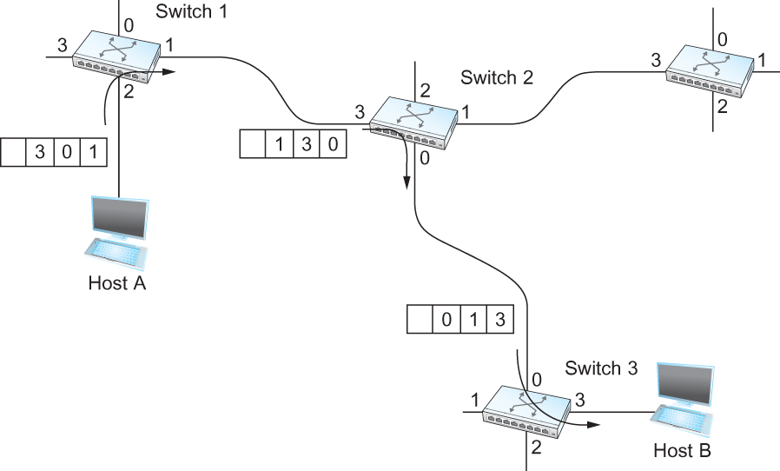
Switching and Forwarding
Source Routing
All the information about network topology that is required to switch a packet across the network is provided by the source host

Slide 40
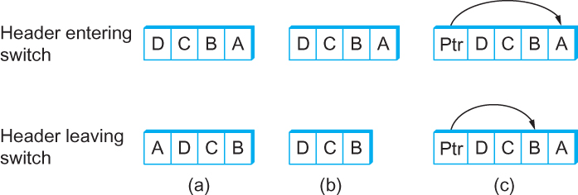
Switching and Forwarding
Other approaches in Source Routing

Slide 41
Bridges and LAN Switches
Bridges and LAN Switches
Class of switches that is used to forward packets between shared-media LANs such as Ethernets
Known as LAN switches
Referred to as Bridges
Suppose you have a pair of Ethernets that you want to interconnect
One approach is put a repeater in between them
It might exceed the physical limitation of the Ethernet
No more than four repeaters between any pair of hosts
No more than a total of 2500 m in length is allowed
An alternative would be to put a node between the two Ethernets and have the node forward frames from one Ethernet to the other
This node is called a Bridge
A collection of LANs connected by one or more bridges is usually said to form an Extended LAN

Slide 42
Bridges and LAN Switches
Simplest Strategy for Bridges
Accept LAN frames on their inputs and forward them out to all other outputs
Used by early bridges
Learning Bridges
Observe that there is no need to forward all the frames that a bridge receives

Slide 43
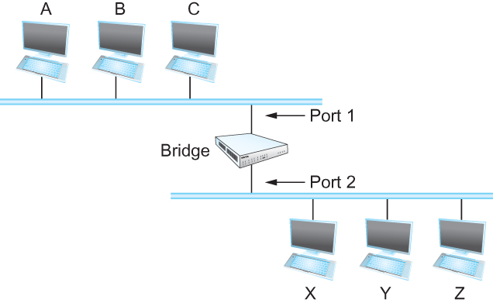
Bridges and LAN Switches
Consider the following figure
When a frame from host A that is addressed to host B arrives on port 1, there is no need for the bridge to forward the frame out over port 2.
How does a bridge come to learn on which port the various hosts reside?

Slide 44
Bridges and LAN Switches
Solution
Download a table into the bridge
Who does the download?
Human
Too much work for maintenance
Host Port
--------------------
A 1
B 1
C 1
X 2
Y 2
Z 2

Slide 45
Bridges and LAN Switches
Can the bridge learn this information by itself?
Yes
How
Each bridge inspects the source address in all the frames it receives
Record the information at the bridge and build the table
When a bridge first boots, this table is empty
Entries are added over time
A timeout is associated with each entry
The bridge discards the entry after a specified period of time
To protect against the situation in which a host is moved from one network to another
If the bridge receives a frame that is addressed to host not currently in the table
Forward the frame out on all other ports

Slide 46
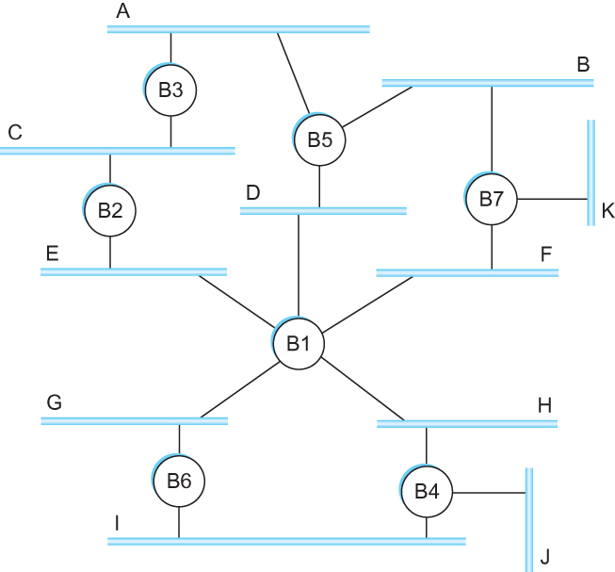
Bridges and LAN Switches
Strategy works fine if the extended LAN does not have a loop in it
Why?
Frames potentially loop through the extended LAN forever
Bridges B1, B4, and B6 form a loop

Slide 47
Bridges and LAN Switches
How does an extended LAN come to have a loop in it?
Network is managed by more than one administrator
For example, it spans multiple departments in an organization
It is possible that no single person knows the entire configuration of the network
A bridge that closes a loop might be added without anyone knowing
Loops are built into the network to provide redundancy in case of failures
Solution
Distributed Spanning Tree Algorithm

Slide 48
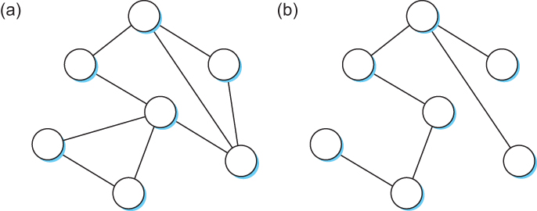
Spanning Tree Algorithm
Think of the extended LAN as being represented by a graph that possibly has loops (cycles)
A spanning tree is a sub-graph of this graph that covers all the vertices but contains no cycles
Spanning tree keeps all the vertices of the original graph but throws out some of the edges
Example of (a) a cyclic graph; (b) a corresponding spanning tree.

Slide 49
Spanning Tree Algorithm
Developed by Radia Perlman at Digital
A protocol used by a set of bridges to agree upon a spanning tree for a particular extended LAN
IEEE 802.1 specification for LAN bridges is based on this algorithm
Each bridge decides the ports over which it is and is not willing to forward frames
In a sense, it is by removing ports from the topology that the extended LAN is reduced to an acyclic tree
It is even possible that an entire bridge will not participate in forwarding frames

Slide 50
Spanning Tree Algorithm
Algorithm is dynamic
The bridges are always prepared to reconfigure themselves into a new spanning tree if some bridges fail
Main idea
Each bridge selects the ports over which they will forward the frames

Slide 51
Spanning Tree Algorithm
Algorithm selects ports as follows:
Each bridge has a unique identifier
B1, B2, B3,…and so on.
Elect the bridge with the smallest id as the root of the spanning tree
The root bridge always forwards frames out over all of its ports
Each bridge computes the shortest path to the root and notes which of its ports is on this path
This port is selected as the bridge’s preferred path to the root
Finally, all the bridges connected to a given LAN elect a single designated bridge that will be responsible for forwarding frames toward the root bridge

Slide 52
Spanning Tree Algorithm
Each LAN’s designated bridge is the one that is closest to the root
If two or more bridges are equally close to the root,
Then select bridge with the smallest id
Each bridge is connected to more than one LAN
So it participates in the election of a designated bridge for each LAN it is connected to.
Each bridge decides if it is the designated bridge relative to each of its ports
The bridge forwards frames over those ports for which it is the designated bridge

Slide 53
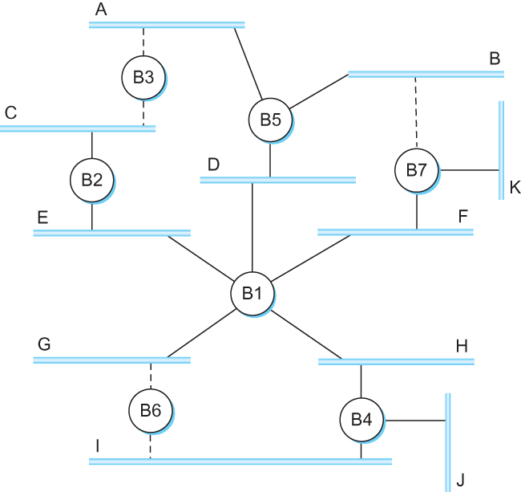
Spanning Tree Algorithm
B1 is the root bridge
B3 and B5 are connected to LAN A, but B5 is the designated bridge
B5 and B7 are connected to LAN B, but B5 is the designated bridge

Slide 54
Spanning Tree Algorithm
Initially each bridge thinks it is the root, so it sends a configuration message on each of its ports identifying itself as the root and giving a distance to the root of 0
Upon receiving a configuration message over a particular port, the bridge checks to see if the new message is better than the current best configuration message recorded for that port
The new configuration is better than the currently recorded information if
It identifies a root with a smaller id or
It identifies a root with an equal id but with a shorter distance or
The root id and distance are equal, but the sending bridge has a smaller id

Slide 55
Spanning Tree Algorithm
If the new message is better than the currently recorded one,
The bridge discards the old information and saves the new information
It first adds 1 to the distance-to-root field
When a bridge receives a configuration message indicating that it is not the root bridge (that is, a message from a bridge with smaller id)
The bridge stops generating configuration messages on its own
Only forwards configuration messages from other bridges after 1 adding to the distance field

Slide 56
Spanning Tree Algorithm
When a bridge receives a configuration message that indicates it is not the designated bridge for that port
=> a message from a bridge that is closer to the root or equally far from the root but with a smaller id
The bridge stops sending configuration messages over that port
When the system stabilizes,
Only the root bridge is still generating configuration messages.
Other bridges are forwarding these messages only over ports for which they are the designated bridge

Slide 57
Spanning Tree Algorithm
Consider the situation when the power had just been restored to the building housing the following network
All bridges would start off by claiming to be the root

Slide 58
Spanning Tree Algorithm
Denote a configuration message from node X in which it claims to be distance d from the root node Y as (Y, d, X)
Consider the activity at node B3

Slide 59
Spanning Tree Algorithm
B3 receives (B2, 0, B2)
Since 2 < 3, B3 accepts B2 as root
B3 adds 1 to the distance advertised by B2 and sends (B2, 1, B3) to B5
Meanwhile B2 accepts B1 as root because it has the lower id and it sends (B1, 1, B2) toward B3
B5 accepts B1 as root and sends (B1, 1, B5) to B3
B3 accepts B1 as root and it notes that both B2 and B5 are closer to the root than it is.
Thus B3 stops forwarding messages on both its interfaces
This leaves B3 with both ports not selected

Slide 60
Spanning Tree Algorithm
Even after the system has stabilized, the root bridge continues to send configuration messages periodically
Other bridges continue to forward these messages
When a bridge fails, the downstream bridges will not receive the configuration messages
After waiting a specified period of time, they will once again claim to be the root and the algorithm starts again
Note
Although the algorithm is able to reconfigure the spanning tree whenever a bridge fails, it is not able to forward frames over alternative paths for the sake of routing around a congested bridge

Slide 61
Spanning Tree Algorithm
Broadcast and Multicast
Forward all broadcast/multicast frames
Current practice
Learn when no group members downstream
Accomplished by having each member of group G send a frame to bridge multicast address with G in source field

Slide 62
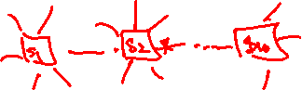
Spanning Tree Algorithm
Limitation of Bridges
Do not scale
Spanning tree algorithm does not scale
Broadcast does not scale
Do not accommodate heterogeneity

Slide 63
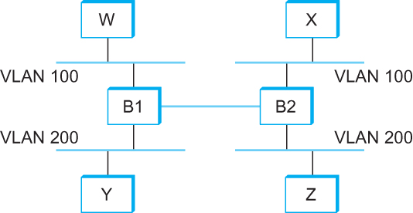
Spanning Tree Algorithm
Virtual LAN

Slide 64
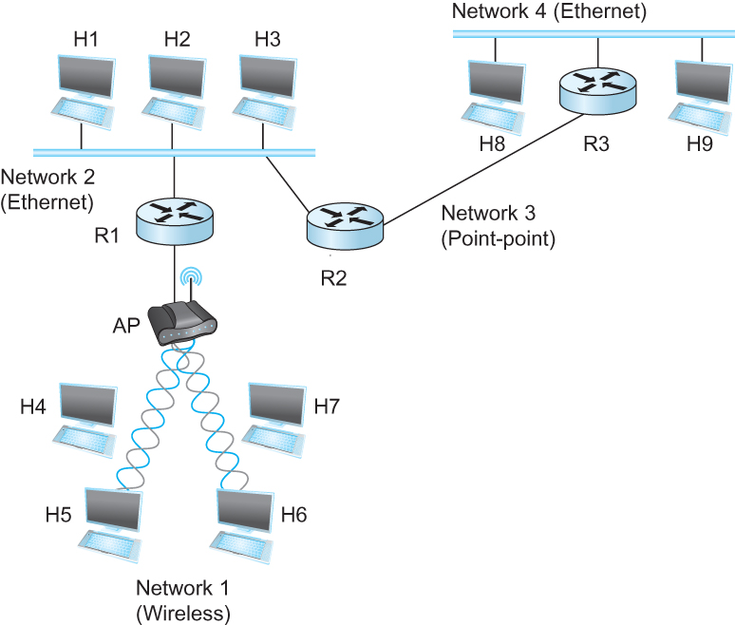
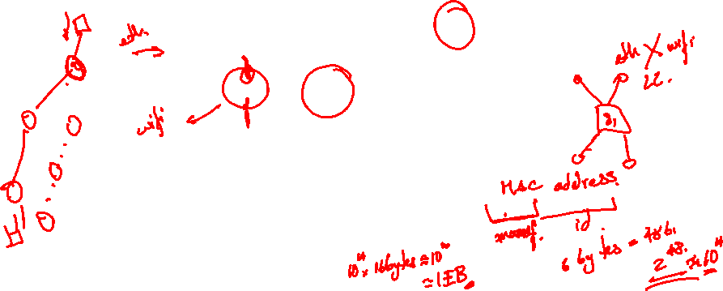
Internetworking
What is internetwork
An arbitrary collection of networks interconnected to provide some sort of host-host to packet delivery service
A simple internetwork where H represents hosts and R represents routers

Slide 65
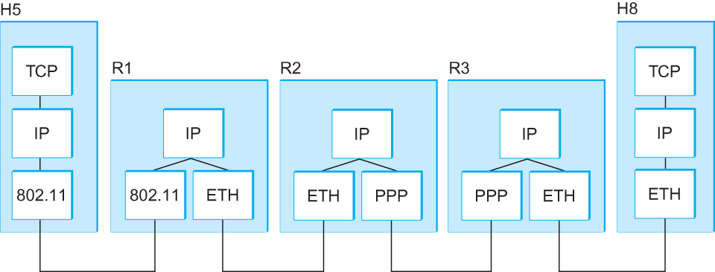
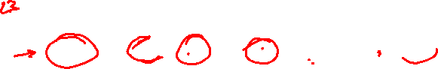
Internetworking
What is IP
IP stands for Internet Protocol
Key tool used today to build scalable, heterogeneous internetworks
It runs on all the nodes in a collection of networks and defines the infrastructure that allows these nodes and networks to function as a single logical internetwork
A simple internetwork showing the protocol layers

Slide 66

IP Service Model
Packet Delivery Model
Connectionless model for data delivery
Best-effort delivery (unreliable service)
packets are lost
packets are delivered out of order
duplicate copies of a packet are delivered
packets can be delayed for a long time
Global Addressing Scheme
Provides a way to identify all hosts in the network

Slide 67
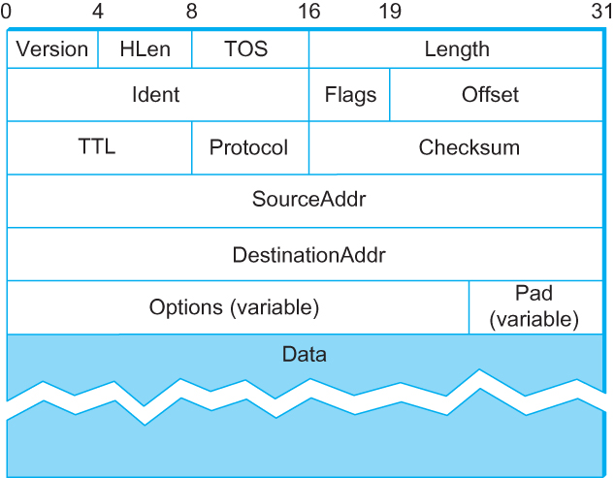
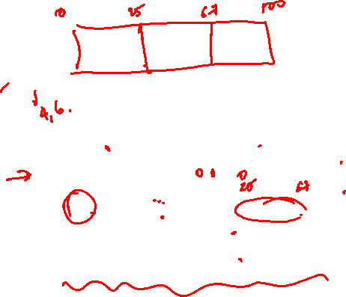
Packet Format
Version (4): currently 4
Hlen (4): number of 32-bit words in header
TOS (8): type of service (not widely used)
Length (16): number of bytes in this datagram
Ident (16): used by fragmentation
Flags/Offset (16): used by fragmentation
TTL (8): number of hops this datagram has traveled
Protocol (8): demux key (TCP=6, UDP=17)
Checksum (16): of the header only
DestAddr & SrcAddr (32)

Slide 68
IP Fragmentation and Reassembly
Each network has some MTU (Maximum Transmission Unit)
Ethernet (1500 bytes), FDDI (4500 bytes)
Strategy
Fragmentation occurs in a router when it receives a datagram that it wants to forward over a network which has (MTU < datagram)
Reassembly is done at the receiving host
All the fragments carry the same identifier in the Ident field
Fragments are self-contained datagrams
IP does not recover from missing fragments

Slide 69
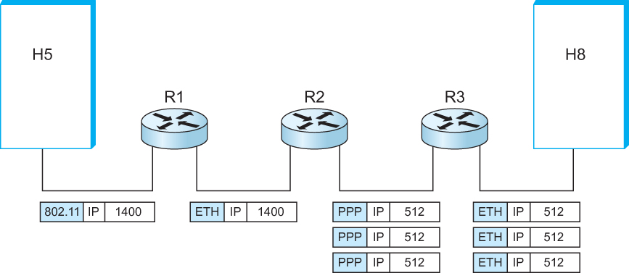
IP Fragmentation and Reassembly
IP datagrams traversing the sequence of physical networks

Slide 70
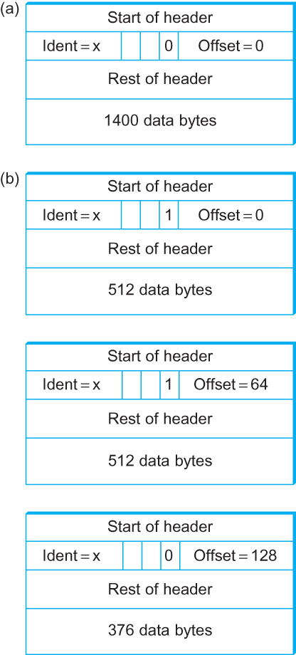
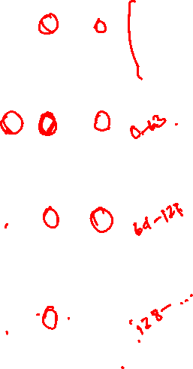
IP Fragmentation and Reassembly
Header fields used in IP fragmentation. (a) Unfragmented packet; (b) fragmented packets.

Slide 71
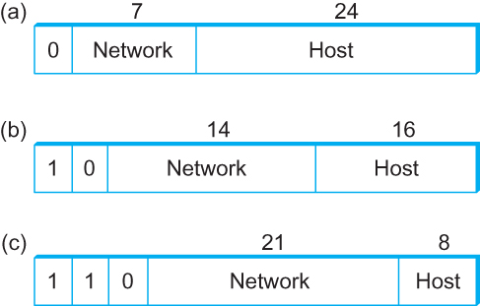
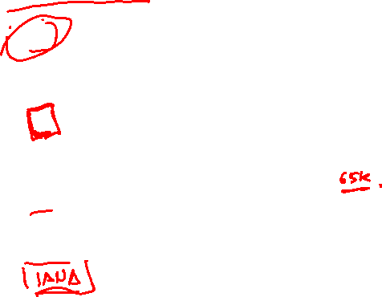
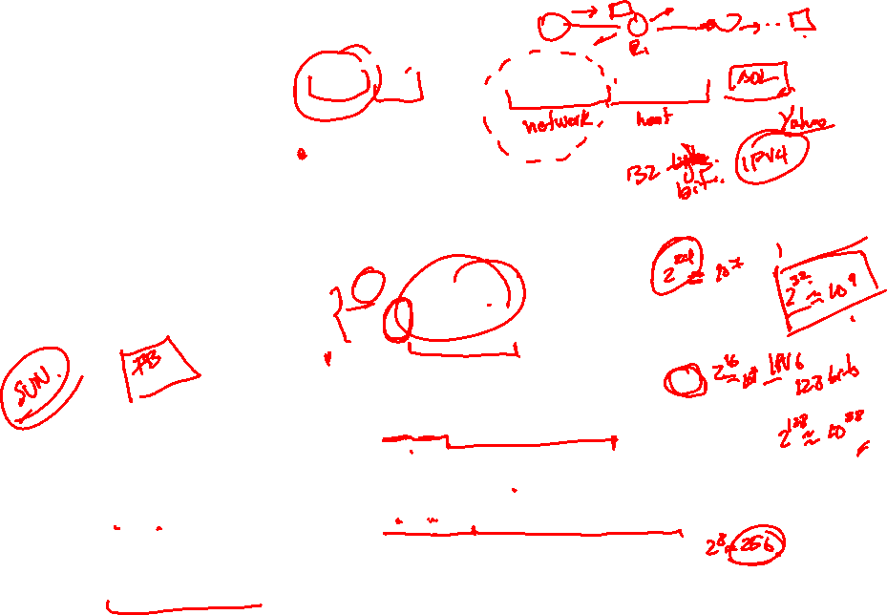
Global Addresses
Properties
globally unique
hierarchical: network + host
4 Billion IP address, half are A type, ¼ is B type, and 1/8 is C type
Format
Dot notation
10.3.2.4
128.96.33.81
192.12.69.77

Slide 72
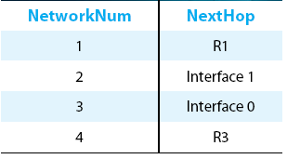
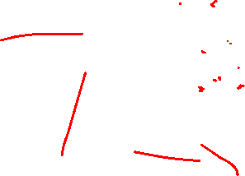
IP Datagram Forwarding
Strategy
every datagram contains destination's address
if directly connected to destination network, then forward to host
if not directly connected to destination network, then forward to some router
forwarding table maps network number into next hop
each host has a default router
each router maintains a forwarding table
Example (router R2)

Slide 73
IP Datagram Forwarding
Algorithm
if (NetworkNum of destination = NetworkNum of one of my interfaces) then
deliver packet to destination over that interface
else
if (NetworkNum of destination is in my forwarding table) then
deliver packet to NextHop router
else
deliver packet to default router
For a host with only one interface and only a default router in its forwarding table, this simplifies to
if (NetworkNum of destination = my NetworkNum)then
deliver packet to destination directly
else
deliver packet to default router

Slide 74
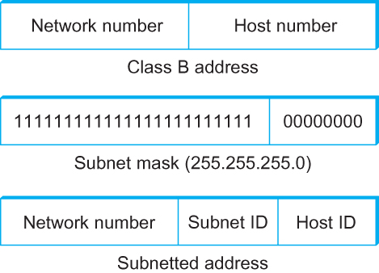
Subnetting
Add another level to address/routing hierarchy: subnet
Subnet masks define variable partition of host part of class A and B addresses
Subnets visible only within site

Slide 75
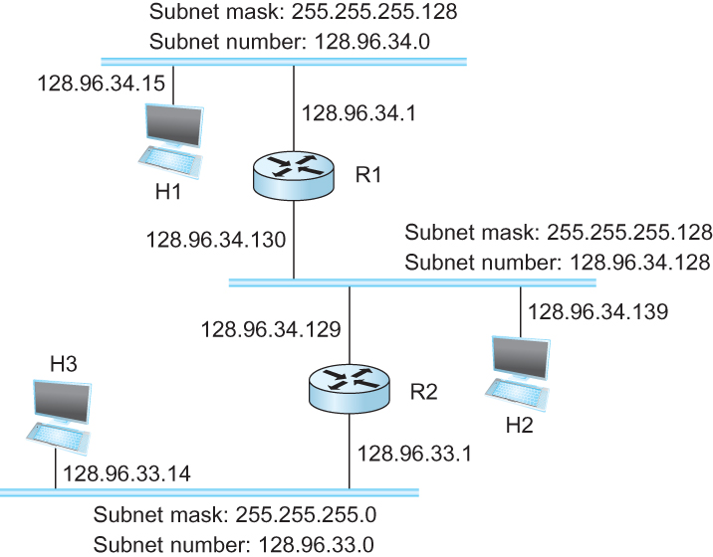
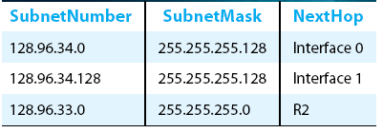
Subnetting
Forwarding Table at Router R1

Slide 76
Subnetting
Forwarding Algorithm
D = destination IP address
for each entry < SubnetNum, SubnetMask, NextHop>
D1 = SubnetMask & D
if D1 = SubnetNum
if NextHop is an interface
deliver datagram directly to destination
else
deliver datagram to NextHop (a router)

Slide 77
Subnetting
Notes
Would use a default router if nothing matches
Not necessary for all ones in subnet mask to be contiguous
Can put multiple subnets on one physical network
Subnets not visible from the rest of the Internet

Slide 78
Classless Addressing
Classless Inter-Domain Routing
A technique that addresses two scaling concerns in the Internet
The growth of backbone routing table as more and more network numbers need to be stored in them
Potential exhaustion of the 32-bit address space
Address assignment efficiency
Arises because of the IP address structure with class A, B, and C addresses
Forces us to hand out network address space in fixed-size chunks of three very different sizes
A network with two hosts needs a class C address
Address assignment efficiency = 2/255 = 0.78
A network with 256 hosts needs a class B address
Address assignment efficiency = 256/65535 = 0.39

Slide 79
Classless Addressing
Exhaustion of IP address space centers on exhaustion of the class B network numbers
Solution
Say “NO” to any Autonomous System (AS) that requests a class B address unless they can show a need for something close to 64K addresses
Instead give them an appropriate number of class C addresses
For any AS with at least 256 hosts, we can guarantee an address space utilization of at least 50%
What is the problem with this solution?

Slide 80
Classless Addressing
Problem with this solution
Excessive storage requirement at the routers.
If a single AS has, say 16 class C network numbers assigned to it,
Every Internet backbone router needs 16 entries in its routing tables for that AS
This is true, even if the path to every one of these networks is the same
If we had assigned a class B address to the AS
The same routing information can be stored in one entry
Efficiency = 16 × 255 / 65, 536 = 6.2%

Slide 81
Classless Addressing
CIDR tries to balance the desire to minimize the number of routes that a router needs to know against the need to hand out addresses efficiently.
CIDR uses aggregate routes
Uses a single entry in the forwarding table to tell the router how to reach a lot of different networks
Breaks the rigid boundaries between address classes

Slide 82
Classless Addressing
Consider an AS with 16 class C network numbers.
Instead of handing out 16 addresses at random, hand out a block of contiguous class C addresses
Suppose we assign the class C network numbers from 192.4.16 through 192.4.31
Observe that top 20 bits of all the addresses in this range are the same (11000000 00000100 0001)
We have created a 20-bit network number (which is in between class B network number and class C number)
Requires to hand out blocks of class C addresses that share a common prefix

Slide 83
Classless Addressing
Requires to hand out blocks of class C addresses that share a common prefix
The convention is to place a /X after the prefix where X is the prefix length in bits
For example, the 20-bit prefix for all the networks 192.4.16 through 192.4.31 is represented as 192.4.16/20
By contrast, if we wanted to represent a single class C network number, which is 24 bits long, we would write it 192.4.16/24

Slide 84
Classless Addressing
How do the routing protocols handle this classless addresses
It must understand that the network number may be of any length
Represent network number with a single pair
<length, value>
All routers must understand CIDR addressing

Slide 85
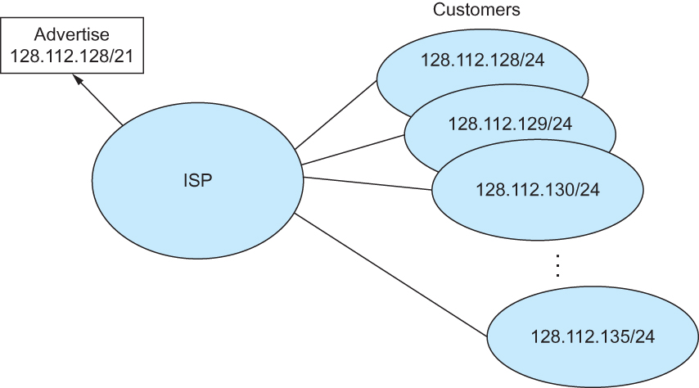
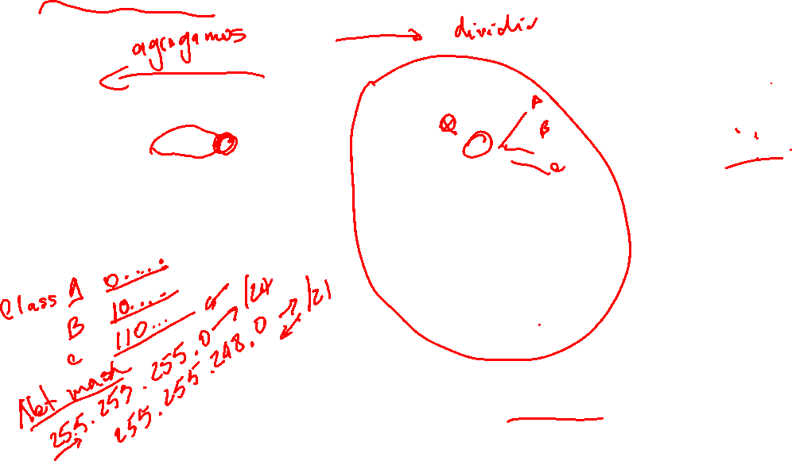
Classless Addressing
Route aggregation with CIDR

Slide 86
IP Forwarding Revisited
IP forwarding mechanism assumes that it can find the network number in a packet and then look up that number in the forwarding table
We need to change this assumption in case of CIDR
CIDR means that prefixes may be of any length, from 2 to 32 bits

Slide 87
IP Forwarding Revisited
It is also possible to have prefixes in the forwarding tables that overlap
Some addresses may match more than one prefix
For example, we might find both 171.69 (a 16 bit prefix) and 171.69.10 (a 24 bit prefix) in the forwarding table of a single router
A packet destined to 171.69.10.5 clearly matches both prefixes.
The rule is based on the principle of “longest match”
171.69.10 in this case
A packet destined to 171.69.20.5 would match 171.69 and not 171.69.10

Slide 88
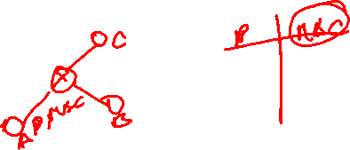
Address Resolution Protocol (ARP)
Map IP addresses into physical addresses
destination host
next hop router
Techniques
encode physical address in host part of IP address
table-based
ARP (Address Resolution Protocol)
table of IP to physical address bindings
broadcast request if IP address not in table
target machine responds with its physical address
table entries are discarded if not refreshed

Slide 89
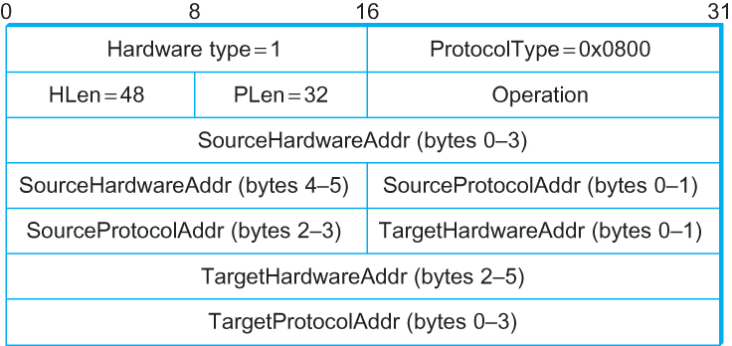
ARP Packet Format
HardwareType: type of physical network (e.g., Ethernet)
ProtocolType: type of higher layer protocol (e.g., IP)
HLEN & PLEN: length of physical and protocol addresses
Operation: request or response
Source/Target Physical/Protocol addresses

Slide 90

Host Configurations
Notes
Ethernet addresses are configured into network by manufacturer and they are unique
IP addresses must be unique on a given internetwork but also must reflect the structure of the internetwork
Most host Operating Systems provide a way to manually configure the IP information for the host
Drawbacks of manual configuration
A lot of work to configure all the hosts in a large network
Configuration process is error-prune
Automated Configuration Process is required

Slide 91
Dynamic Host Configuration Protocol (DHCP)
DHCP server is responsible for providing configuration information to hosts
There is at least one DHCP server for an administrative domain
DHCP server maintains a pool of available addresses

Slide 92
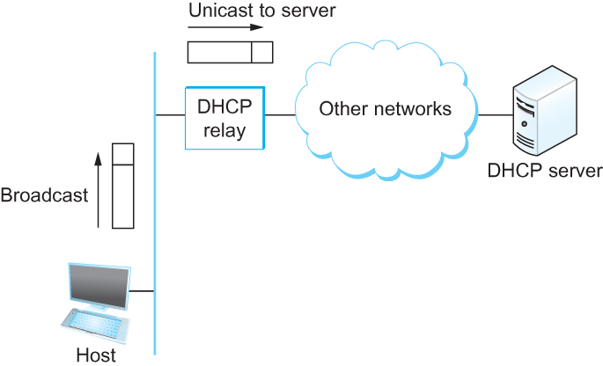
DHCP
Newly booted or attached host sends DHCPDISCOVER message to a special IP address (255.255.255.255)
DHCP relay agent unicasts the message to DHCP server and waits for the response

Slide 93
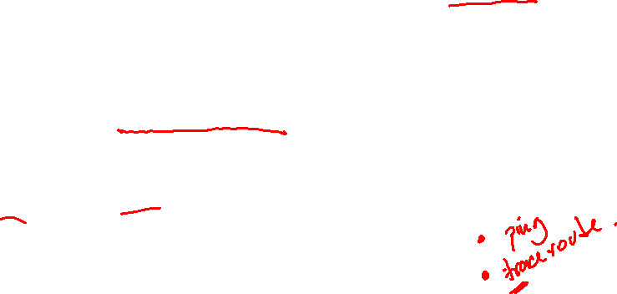
Internet Control Message Protocol (ICMP)
Defines a collection of error messages that are sent back to the source host whenever a router or host is unable to process an IP datagram successfully
Destination host unreachable due to link /node failure
Reassembly process failed
TTL had reached 0 (so datagrams don't cycle forever)
IP header checksum failed
ICMP-Redirect
From router to a source host
With a better route information

Slide 94
Internet Control Message Protocol (ICMP)
Defines a collection of error messages that are sent back to the source host whenever a router or host is unable to process an IP datagram successfully
Destination host unreachable due to link /node failure
Reassembly process failed
TTL had reached 0 (so datagrams don't cycle forever)
IP header checksum failed
ICMP-Redirect
From router to a source host
With a better route information

Slide 95

Routing
Forwarding versus Routing
Forwarding:
to select an output port based on destination address and routing table
Routing:
process by which routing table is built

Slide 96
Routing
Forwarding table VS Routing table
Forwarding table
Used when a packet is being forwarded and so must contain enough information to accomplish the forwarding function
A row in the forwarding table contains the mapping from a network number to an outgoing interface and some MAC information, such as Ethernet Address of the next hop
Routing table
Built by the routing algorithm as a precursor to build the forwarding table
Generally contains mapping from network numbers to next hops

Slide 97


Routing
Example rows from (a) routing and (b) forwarding tables

Slide 98

Routing
Network as a Graph
The basic problem of routing is to find the lowest-cost path between any two nodes
Where the cost of a path equals the sum of the costs of all the edges that make up the path

Slide 99
Routing
For a simple network, we can calculate all shortest paths and load them into some nonvolatile storage on each node.
Such a static approach has several shortcomings
It does not deal with node or link failures
It does not consider the addition of new nodes or links
It implies that edge costs cannot change
What is the solution?
Need a distributed and dynamic protocol
Two main classes of protocols
Distance Vector
Link State

Slide 100

Distance Vector
Each node constructs a one dimensional array (a vector) containing the “distances” (costs) to all other nodes and distributes that vector to its immediate neighbors
Starting assumption is that each node knows the cost of the link to each of its directly connected neighbors

Slide 101

Distance Vector
Initial distances stored at each node (global view)

Slide 102

Distance Vector
Initial routing table at node A

Slide 103

Distance Vector
Final routing table at node A

Slide 104

Distance Vector
Final distances stored at each node (global view)

Slide 105
Distance Vector
The distance vector routing algorithm is sometimes called as Bellman-Ford algorithm
Every T seconds each router sends its table to its neighbor each each router then updates its table based on the new information
Problems include fast response to good new and slow response to bad news. Also too many messages to update

Slide 106
Distance Vector
When a node detects a link failure
F detects that link to G has failed
F sets distance to G to infinity and sends update to A
A sets distance to G to infinity since it uses F to reach G
A receives periodic update from C with 2-hop path to G
A sets distance to G to 3 and sends update to F
F decides it can reach G in 4 hops via A

Slide 107
Distance Vector
Slightly different circumstances can prevent the network from stabilizing
Suppose the link from A to E goes down
In the next round of updates, A advertises a distance of infinity to E, but B and C advertise a distance of 2 to E
Depending on the exact timing of events, the following might happen
Node B, upon hearing that E can be reached in 2 hops from C, concludes that it can reach E in 3 hops and advertises this to A
Node A concludes that it can reach E in 4 hops and advertises this to C
Node C concludes that it can reach E in 5 hops; and so on.
This cycle stops only when the distances reach some number that is large enough to be considered infinite
Count-to-infinity problem

Slide 108
Count-to-infinity Problem
Use some relatively small number as an approximation of infinity
For example, the maximum number of hops to get across a certain network is never going to be more than 16
One technique to improve the time to stabilize routing is called split horizon
When a node sends a routing update to its neighbors, it does not send those routes it learned from each neighbor back to that neighbor
For example, if B has the route (E, 2, A) in its table, then it knows it must have learned this route from A, and so whenever B sends a routing update to A, it does not include the route (E, 2) in that update

Slide 109
Count-to-infinity Problem
In a stronger version of split horizon, called split horizon with poison reverse
B actually sends that back route to A, but it puts negative information in the route to ensure that A will not eventually use B to get to E
For example, B sends the route (E, ∞) to A

Slide 110


Routing Information Protocol (RIP)
Example Network
running RIP RIPv2 Packet Format

Slide 111
Link State Routing
Strategy: Send to all nodes (not just neighbors) information about directly connected links (not entire routing table).
Link State Packet (LSP)
id of the node that created the LSP
cost of link to each directly connected neighbor
sequence number (SEQNO)
time-to-live (TTL) for this packet
Reliable Flooding
store most recent LSP from each node
forward LSP to all nodes but one that sent it
generate new LSP periodically; increment SEQNO
start SEQNO at 0 when reboot
decrement TTL of each stored LSP; discard when TTL=0

Slide 112

Link State
Reliable Flooding
Flooding of link-state packets. (a) LSP arrives at node X; (b) X floods LSP to A and C; (c) A and C flood LSP to B (but not X); (d) flooding is complete

Slide 113
Shortest Path Routing
Dijkstra’s Algorithm - Assume non-negative link weights
N: set of nodes in the graph
l((i, j): the non-negative cost associated with the edge between nodes i, j ∈N and l(i, j) = ∝ if no edge connects i and j
Let s ∈N be the starting node which executes the algorithm to find shortest paths to all other nodes in N
Two variables used by the algorithm
M: set of nodes incorporated so far by the algorithm
C(n) : the cost of the path from s to each node n
The algorithm
M = {s}
For each n in N – {s}
C(n) = l(s, n)
while ( N ≠ M)
M = M ∪ {w} such that C(w) is the minimum
for all w in (N-M)
For each n in (N-M)
C(n) = MIN (C(n), C(w) + l(w, n))

Slide 114
Shortest Path Routing
# Chapter Subtitle
In practice, each switch computes its routing table directly from the LSP’s it has collected using a realization of Dijkstra’s algorithm called the forward search algorithm
Specifically each switch maintains two lists, known as Tentative and Confirmed
Each of these lists contains a set of entries of the form (Destination, Cost, NextHop)

Slide 115
Shortest Path Routing
The algorithm
Initialize the Confirmed list with an entry for myself; this entry has a cost of 0
For the node just added to the Confirmed list in the previous step, call it node Next, select its LSP
For each neighbor (Neighbor) of Next, calculate the cost (Cost) to reach this Neighbor as the sum of the cost from myself to Next and from Next to Neighbor
If Neighbor is currently on neither the Confirmed nor the Tentative list, then add (Neighbor, Cost, Nexthop) to the Tentative list, where Nexthop is the direction I go to reach Next
If Neighbor is currently on the Tentative list, and the Cost is less than the currently listed cost for the Neighbor, then replace the current entry with (Neighbor, Cost, Nexthop) where Nexthop is the direction I go to reach Next
If the Tentative list is empty, stop. Otherwise, pick the entry from the Tentative list with the lowest cost, move it to the Confirmed list, and return to Step 2.

Slide 116


Shortest Path Routing

Slide 117


Open Shortest Path First (OSPF)
OSPF Header Format OSPF Link State Advertisement

Slide 118

Implementation
Routers and switches are often implemented using specialized hardware.
Software-defined networking is disaggregating the software from commodity switching hardware
Example of a
modern switch

Slide 119
Perspective
Virtual networks have been around for over 20 years (VLANs, VPNs)
Network virtualization has emerged more recently as part of the SDN movement
Virtual networks are easily provisioned, modified, deleted, and can be nested
Analogous to virtual machines and with comparable impact on operations

Slide 120
Summary
We have looked at some of the issues involved in building scalable and heterogeneous networks by using switches and routers to interconnect links and networks.
To deal with heterogeneous networks, we have discussed in details the service model of Internetworking Protocol (IP) which forms the basis of today’s routers.
We have discussed in details two major classes of routing algorithms
Distance Vector
Link State

